Slide 1
Resilience of Biological Networks
March 4th 2016
Mohammed Ali Shamrani
McGill University, Montreal, Canada
NII intern with Dr. Inoue-sensei

Slide 2
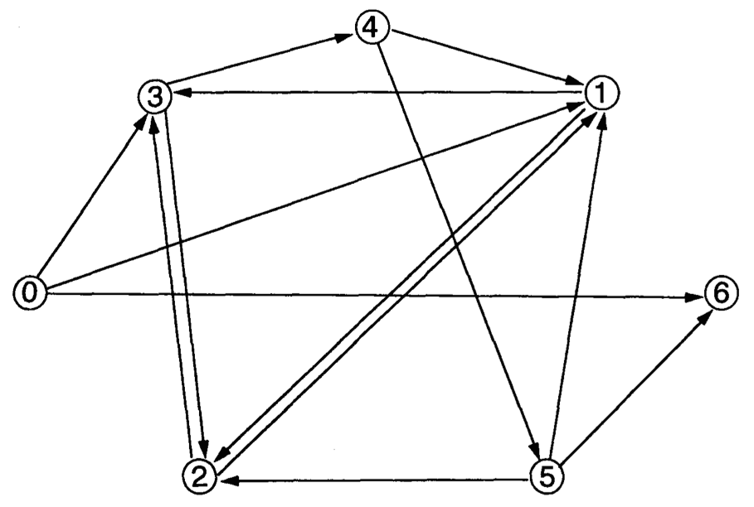
Biological networks can be represented as a directed graph:
Nodes = genes
Directed edges = interactions

Slide 3
Biological networks can be represented as a directed graph:
Nodes = genes
Directed edges = interactions
An interaction can be promotional (+) or inhibitory (-) in nature

Slide 4
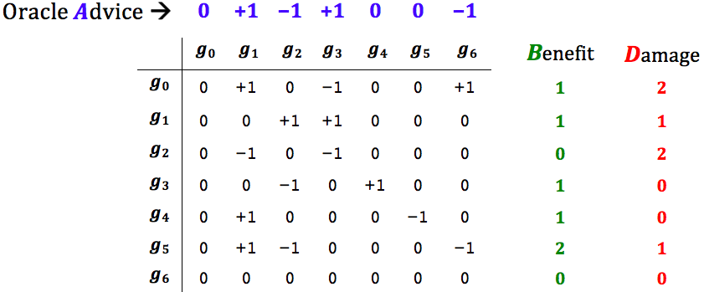
The above graph represented as an adjacency matrix:

Slide 5
+ or – to signify the nature of the interaction: promotional (+)
or
inhibitory (-)

Slide 6
(hypothetical)

Slide 7
Oracle says:
g₁ and g₃ should be up (+)
g₂ and g₆ should be down (-)

Slide 8
Oracle says:
g₁ and g₃ should be up (+)
g₂ and g₆ should be down (-)

Slide 10
Q: What genes should one turn on/off (by external intervention) so as to
maximize the total Benefit ?

Slide 11
Q: What genes should one turn on/off (by external intervention) so as to
maximize the total Benefit ?
A: Faithfully follow the Oracle advice and get the all the Benefits = 1+1+0+1+1+2+0 = 6

Slide 12
Q: What genes should one turn on/off (by external intervention) so as to
maximize the total Benefit ?
A: Faithfully follow the Oracle advice and get the all the Benefits = 1+1+0+1+1+2+0 = 6
But ... you also get all the Damages = 2+1+2+0+0+1+0 = 6

Slide 13
Q: What genes should one turn on/off (by external intervention) so as to
maximize the total Benefit while keeping the total Damages <= 3?

Slide 14
Q: What genes should one turn on/off (by external intervention) so as to
maximize the total Benefit while keeping the total Damages <= 3?
A: Turn on g₀ & g₃ & g₄ & g₅
Turn off g₁ & g₂

Slide 15
Q: What genes should one turn on/off (by external intervention) so as to
maximize the total Benefit while keeping the total Damages <= 3?
A: Turn on g₀ & g₃ & g₄ & g₅
Turn off g₁ & g₂
Optimal solution:
Total B = 5 , Total D = 3

Slide 16
Which genes would you turn on/off to achieve maximal total Benefit while total
Damage <= T ?
Problem Definition

Slide 17
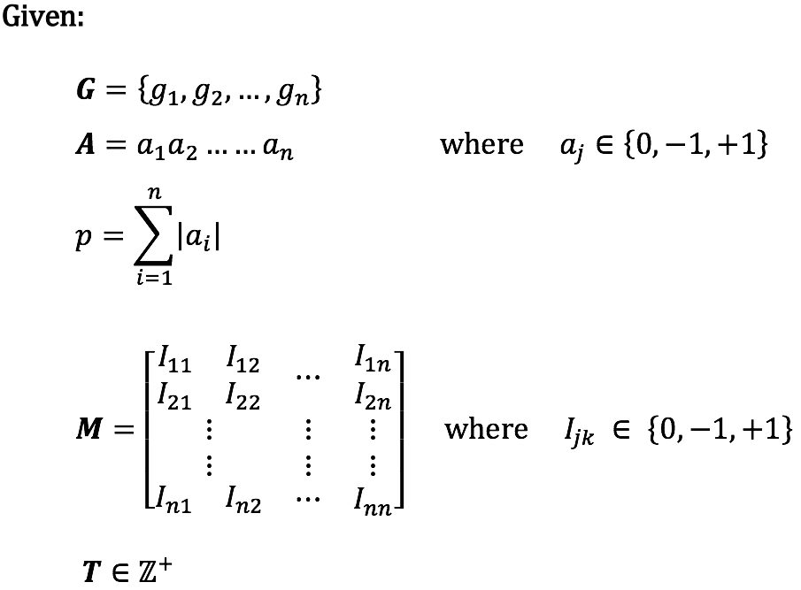
Problem Definition

Slide 18
Problem Definition
Set of genes
Oracle Advice (trinary string)
Pressure (the number of nodes towards which the Oracle is not indifferent)
Interaction matrix
Tolerance (the number of Oracle-advice-contradicting edges to be tolerated)

Slide 19
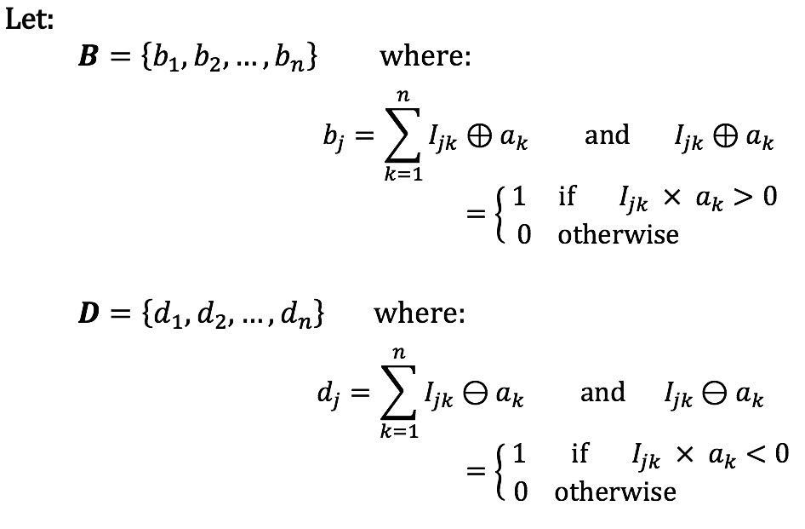
Problem Definition
Benefits
Damages
For each Beneficial/damaging edge, add 1 point to the benefit/damage score of both source (projection, out-degree-dependent) and target (attraction, in-degree-dependent)

Slide 20
Problem Definition
Benefits
Damages
For each Beneficial/damaging edge, add 1 point to the benefit/damage score of both source (projection, out-degree-dependent) and target (attraction, in-degree-dependent)
> This assumes that all interactions are equally potent, which in reality is not the case.

Slide 21
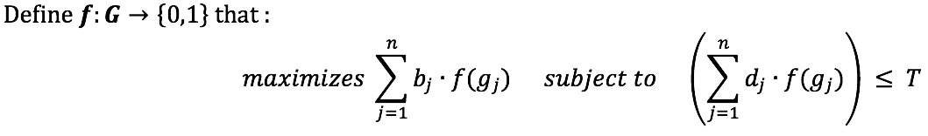
Problem Definition

Slide 22
Which genes would you turn on/off to achieve maximal total Benefit while total
Damage <= T ?
Problem Definition
Forcibly turn on/off (or, equivalently, select-for/delete) genes so as to maximize the total number of interactions (edges) supporting an Oracle advice while minimizing the total number of interactions (edges) that contradict it.

Slide 23
Which genes would you turn on/off to achieve maximal total Benefit while total
Damage <= T ?
Problem Definition
Cellular Regulation
Genomic Evolution
Forcibly turn on/off (or, equivalently, select-for/delete) genes so as to maximize the total number of interactions (edges) supporting an Oracle advice while minimizing the total number of interactions (edges) that contradict it.

Slide 24
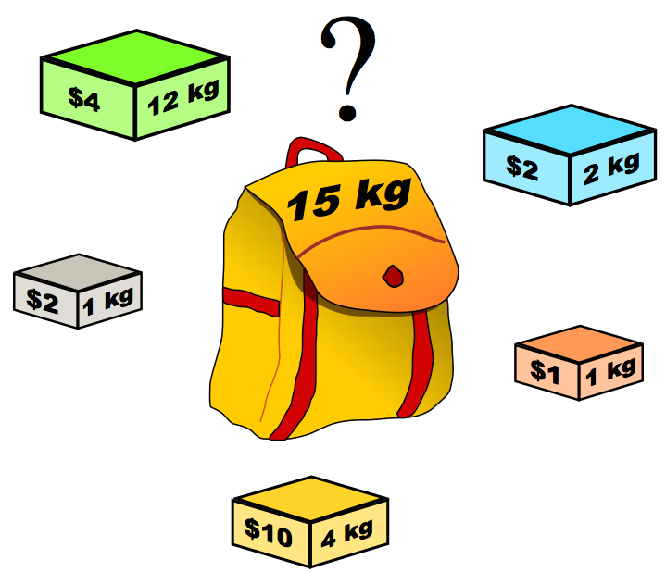
Which genes would you turn on/off to achieve maximal total Benefit while total
Damage <= T ?
Problem Definition
This problem is NP-hard by reduction from the Knapsack optimization problem
M. A. Shamrani, J. Waldispühl, F. Major. "Evolution by Computational Selection." arXiv preprint arXiv:1505.02348 (2015).

Slide 25
Case study:
A protein-protein interaction (PPI) network¹:
- Experimentally validated interactions and
- Machine-learned edge signs (promotional/inhibitory interactions)
- 3352 genes (nodes), 6093 interactions (edges)
¹ Vinayagam, Arunachalam, et al. "Integrating protein-protein interaction networks with phenotypes reveals signs of interactions." Nature methods 11.1 (2014): 94-99.

Slide 26
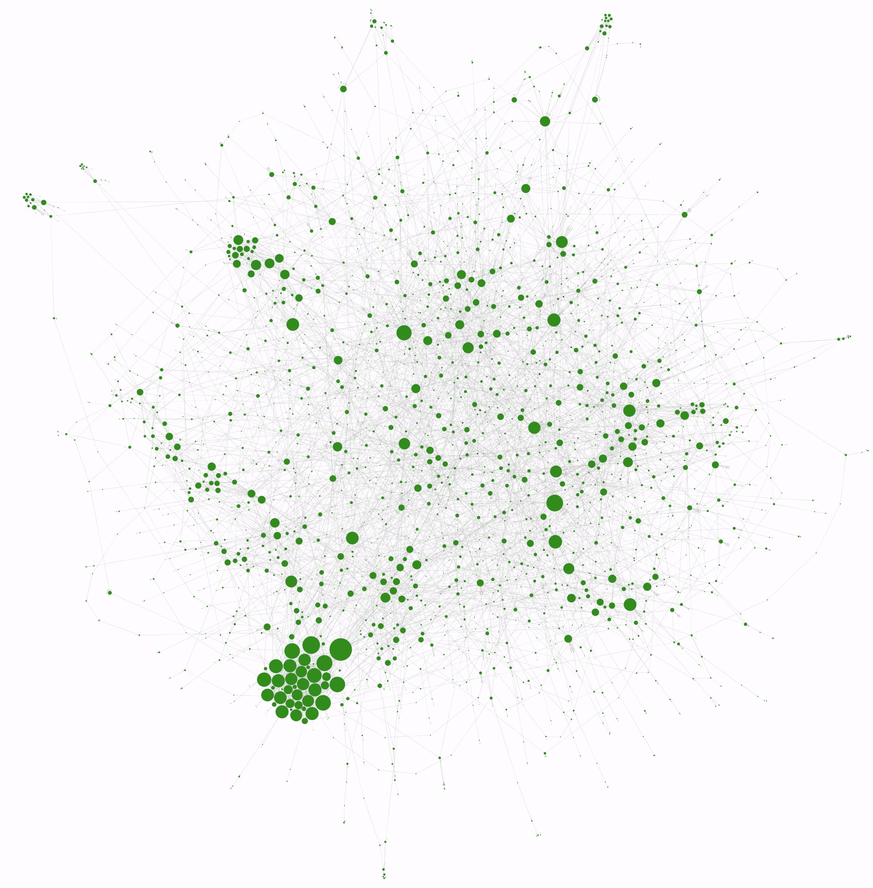
Case study:
A protein-protein interaction (PPI) network¹:
- Experimentally validated interactions and
- Machine-learned edge signs (promotional/inhibitory interactions)
- 3352 genes (nodes), 6093 interactions (edges)
¹Vinayagam, Arunachalam, et al. "Integrating protein-protein interaction networks with phenotypes reveals signs of interactions." Nature methods 11.1 (2014): 94-99.
Topology

Slide 27
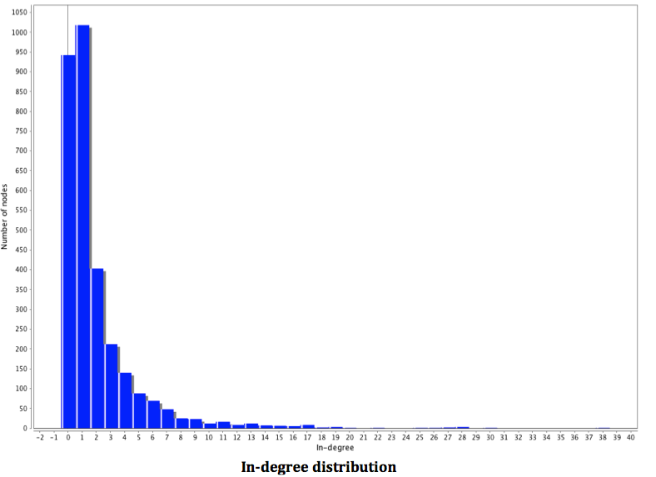
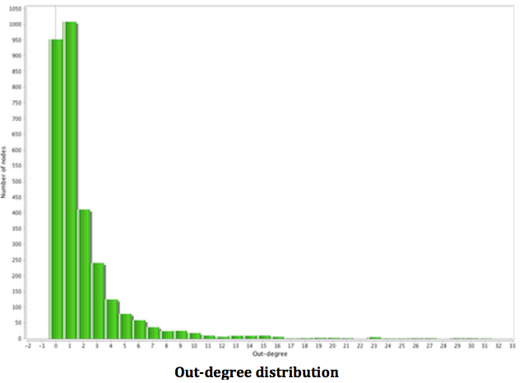
Case study:
A protein-protein interaction (PPI) network:
- Experimentally validated interactions and
- Machine-learned edge signs (promotional/inhibitory interactions)
- 3352 genes (nodes), 6093 interactions (edges)
Vinayagam, Arunachalam, et al. "Integrating protein-protein interaction networks with phenotypes reveals signs of interactions." Nature methods 11.1 (2014): 94-99.
number of nodes
number of nodes
In-degree
Out-degree

Slide 28
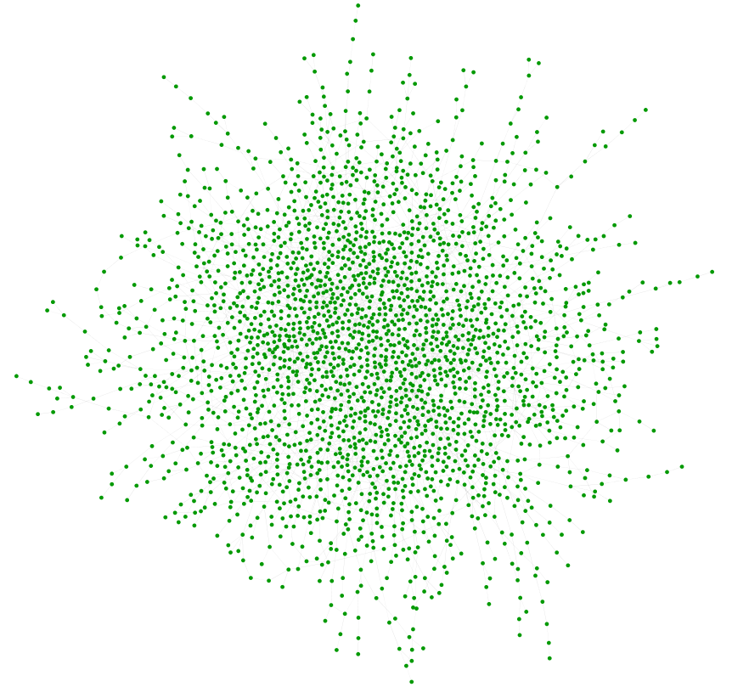
Case study:
A protein-protein interaction (PPI) network:
- Experimentally validated interactions and
- Machine-learned edge signs (promotional/inhibitory interactions)
- 3352 genes (nodes), 6093 interactions (edges)
Against a randomly generated network generated with Erdos-Renyi (ER) model:
- Same number of nodes/edges as PPI, but different degree distribution (flattened)
- Random edge signs (coin flip)
Topology

Slide 29
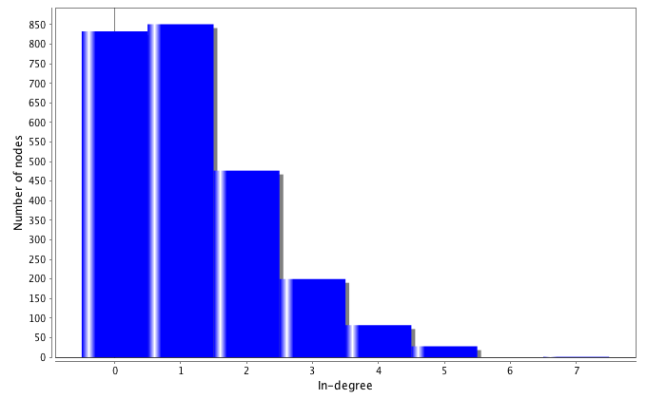
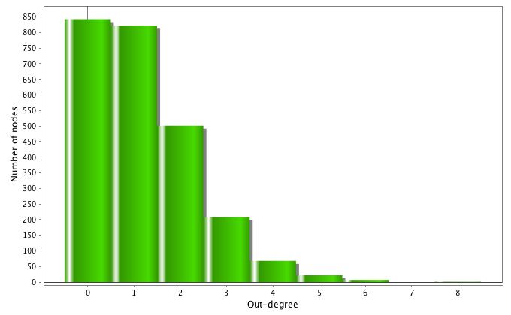
Case study:
A protein-protein interaction (PPI) network:
- Experimentally validated interactions and
- Machine-learned edge signs (promotional/inhibitory interactions)
- 3352 genes (nodes), 6093 interactions (edges)
Against a randomly generated network generated with Erdos-Renyi (ER) model:
- Same number of nodes/edges as PPI, but different degree distribution (flattened)
- Random edge signs (coin flip)
Number of nodes
Number of nodes
In-degree
Out-degree

Slide 30
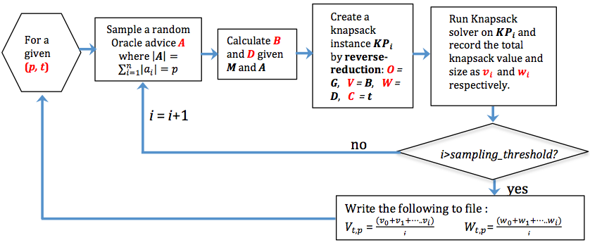
Simulation workflow: stress-test each network against randomly generated Oracle advices (pressure) with varying degrees of tolerance (tolerated edges acting against Oracle advice)

Slide 31
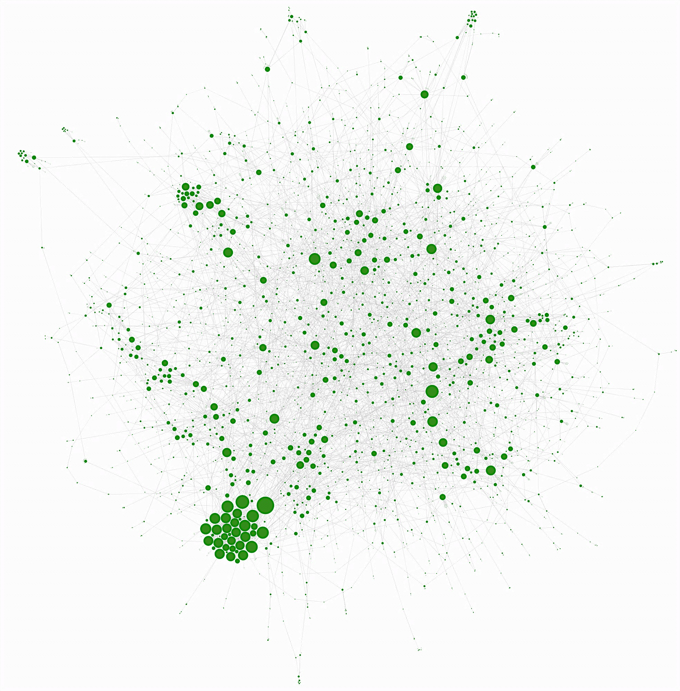
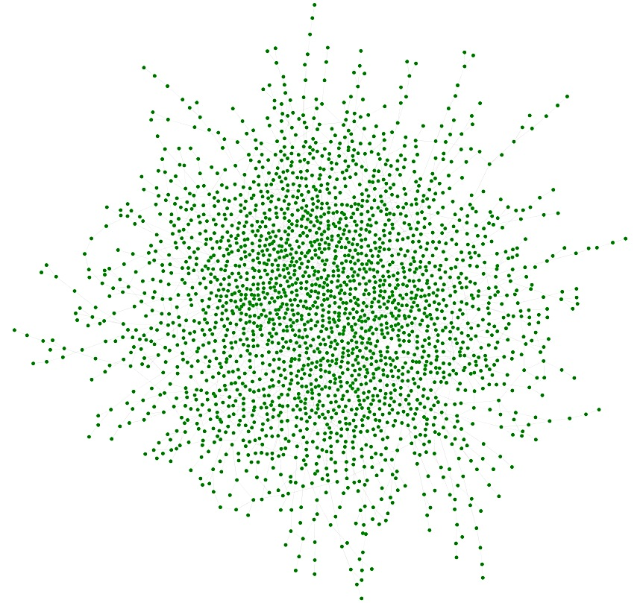
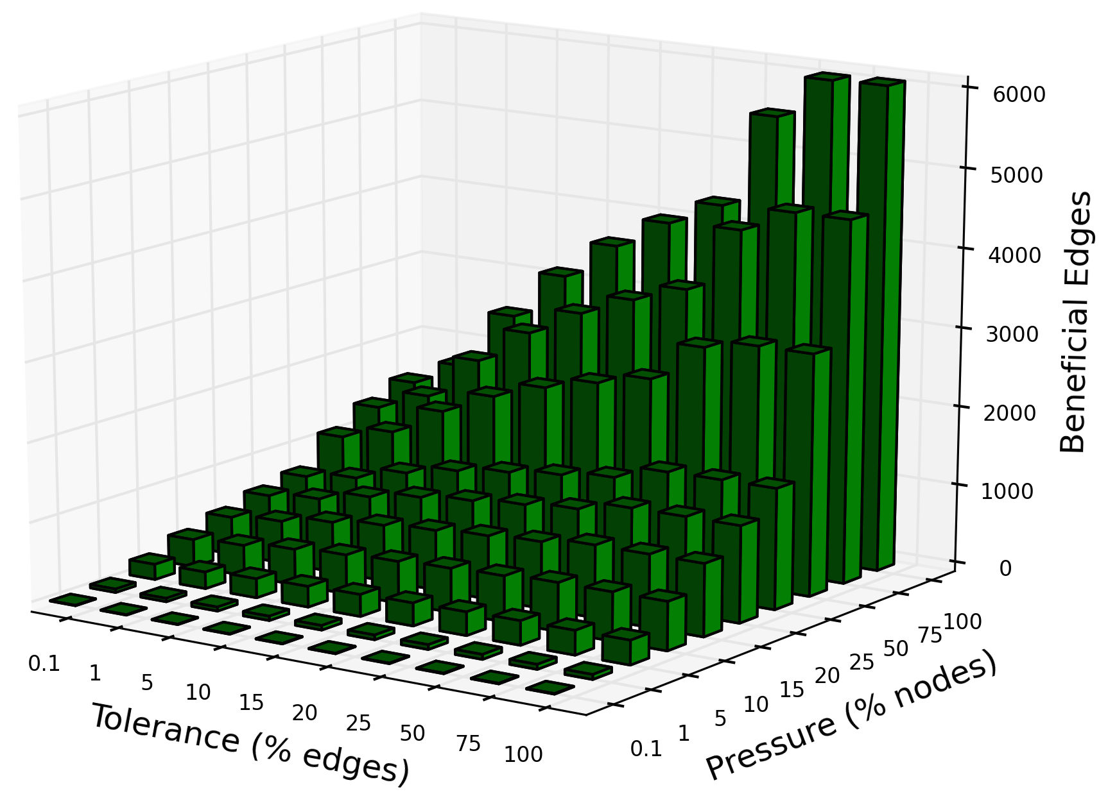
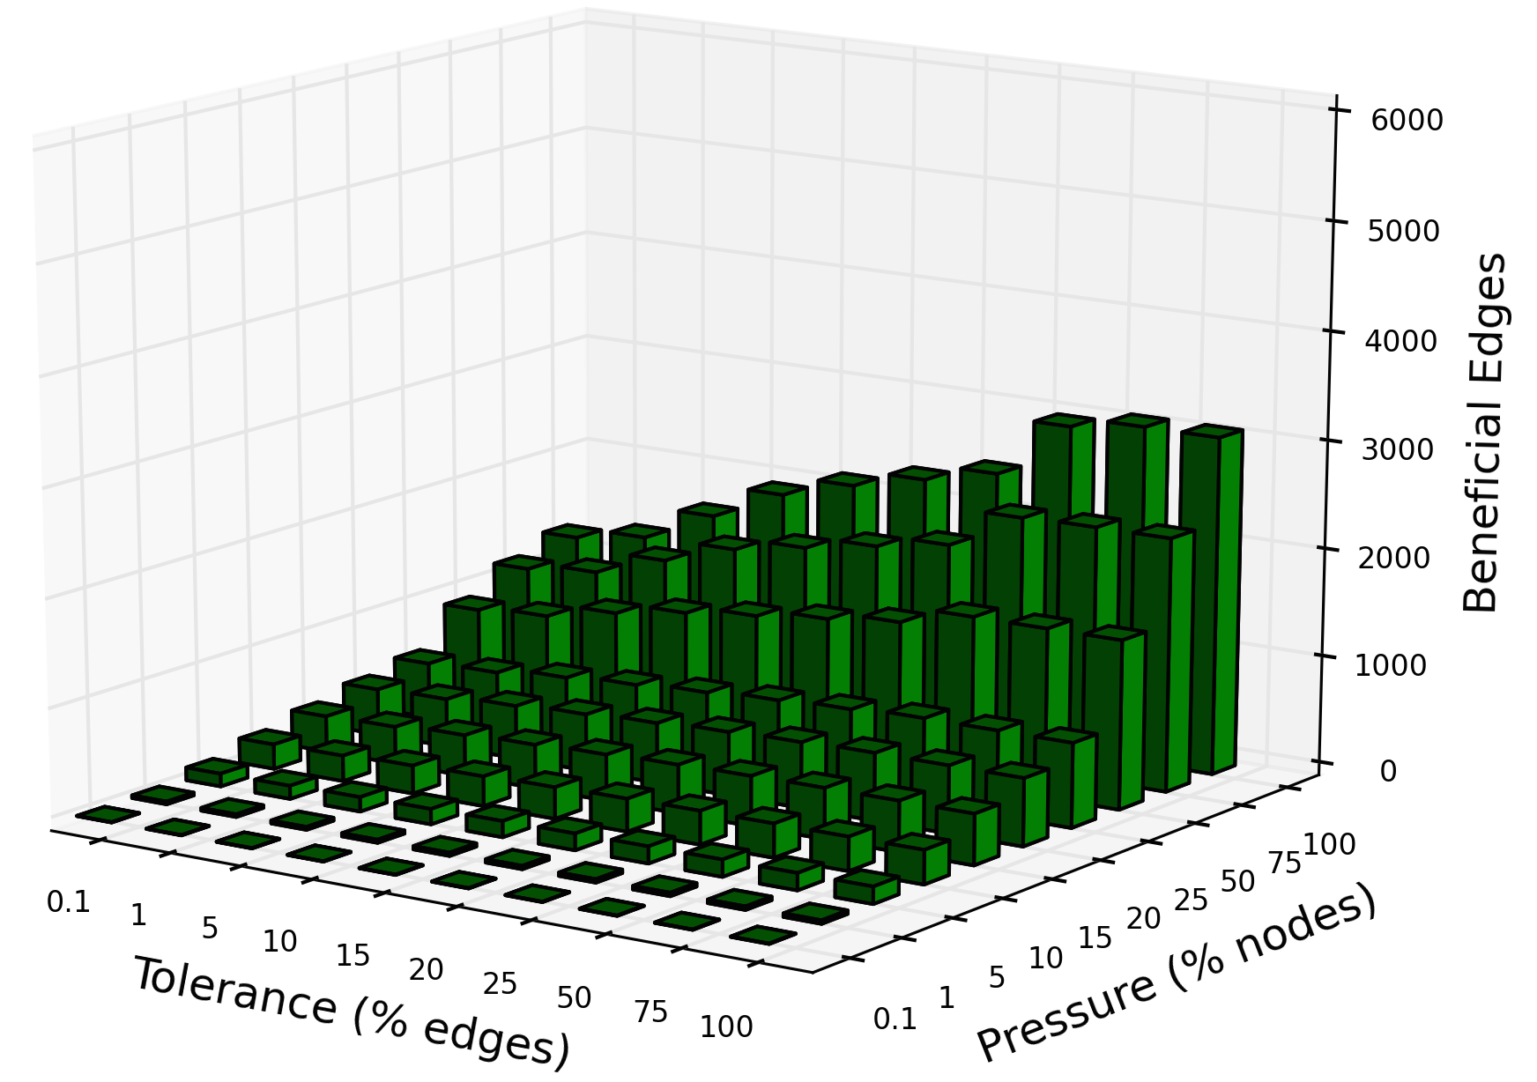
PPI (real bio-network)
ER (PPI’s random analogue)
The average total Benefits (=total knapsack value) in the optimal solution

Slide 32
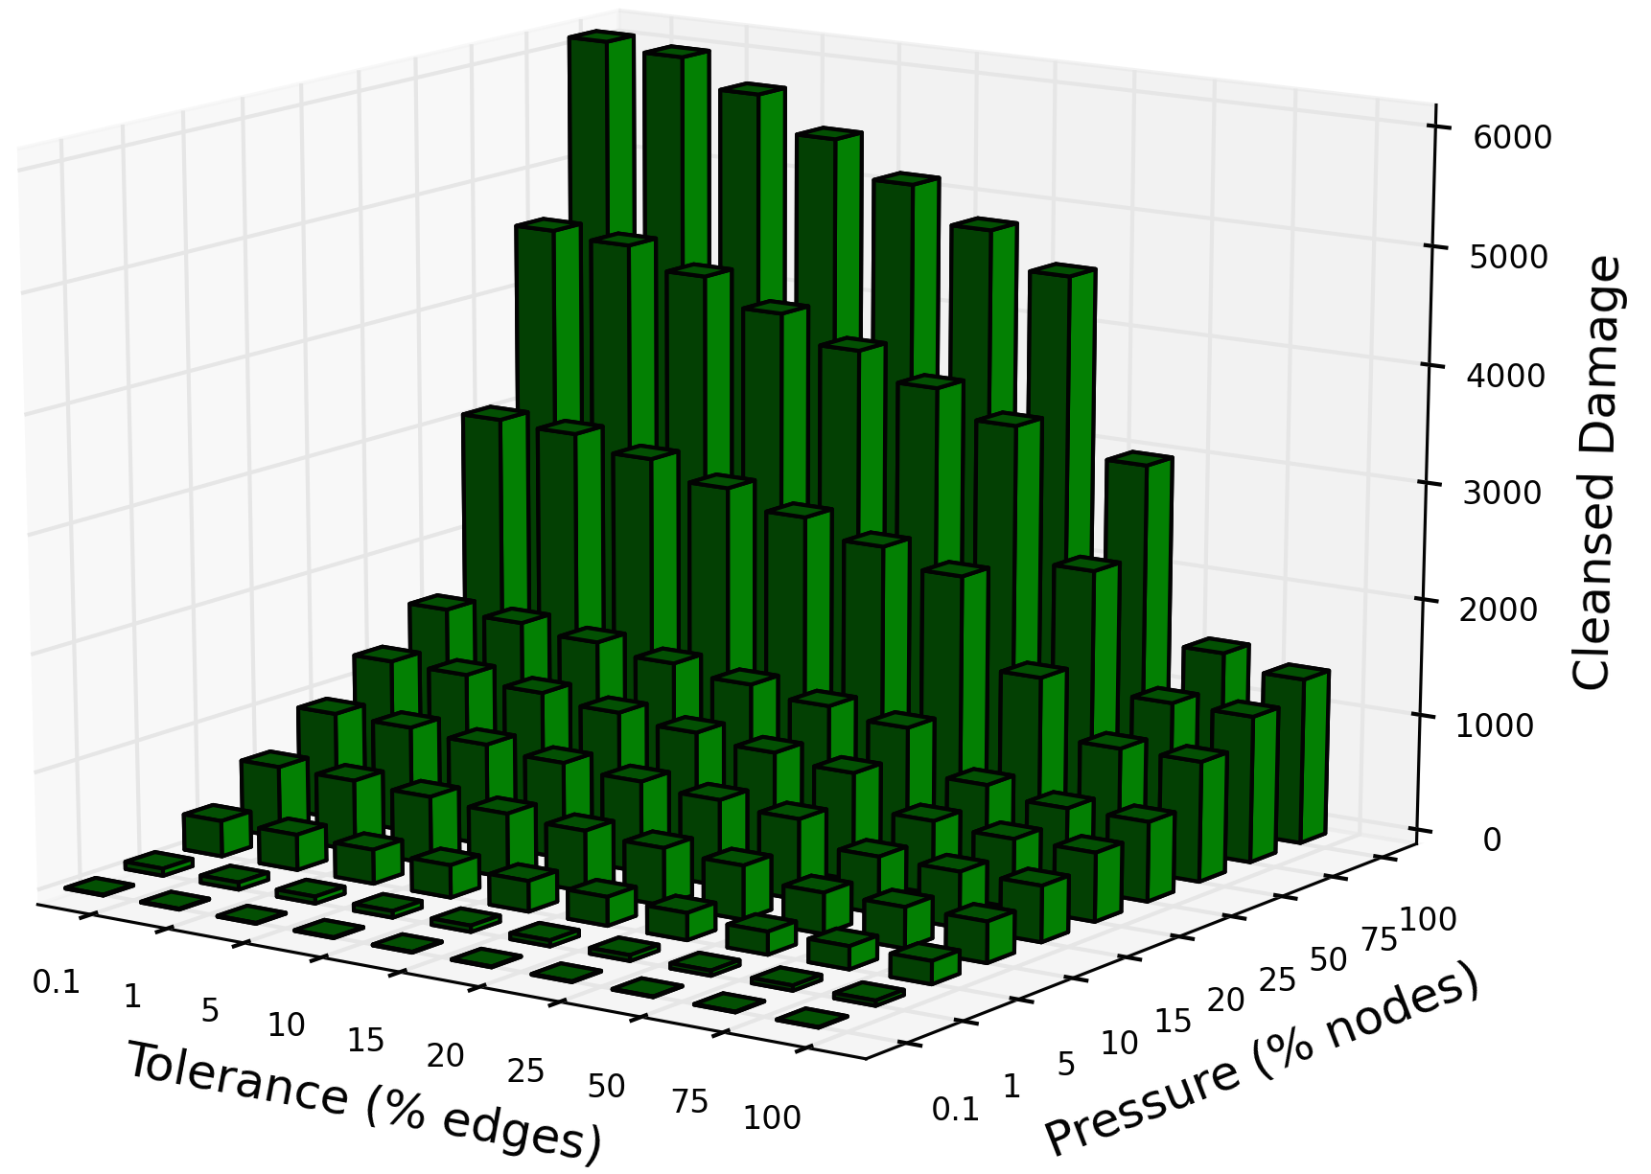
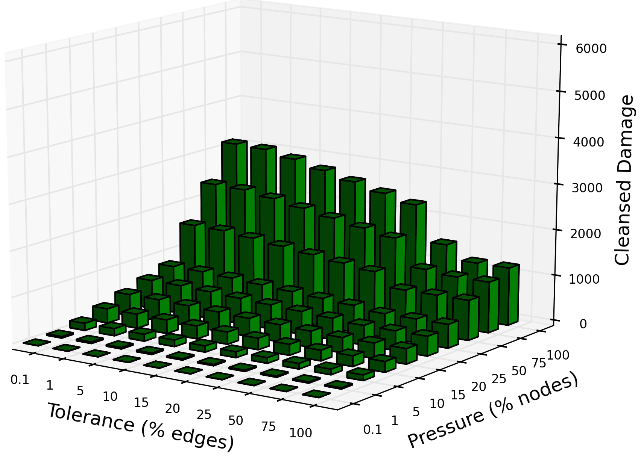
PPI (real bio-network)
ER (PPI’s random analogue)
The average total cleansed Damages (=damages outside the knapsack ) in the optimal solution

Slide 33
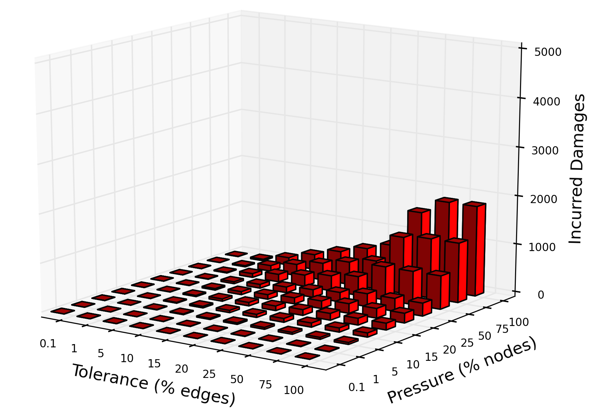
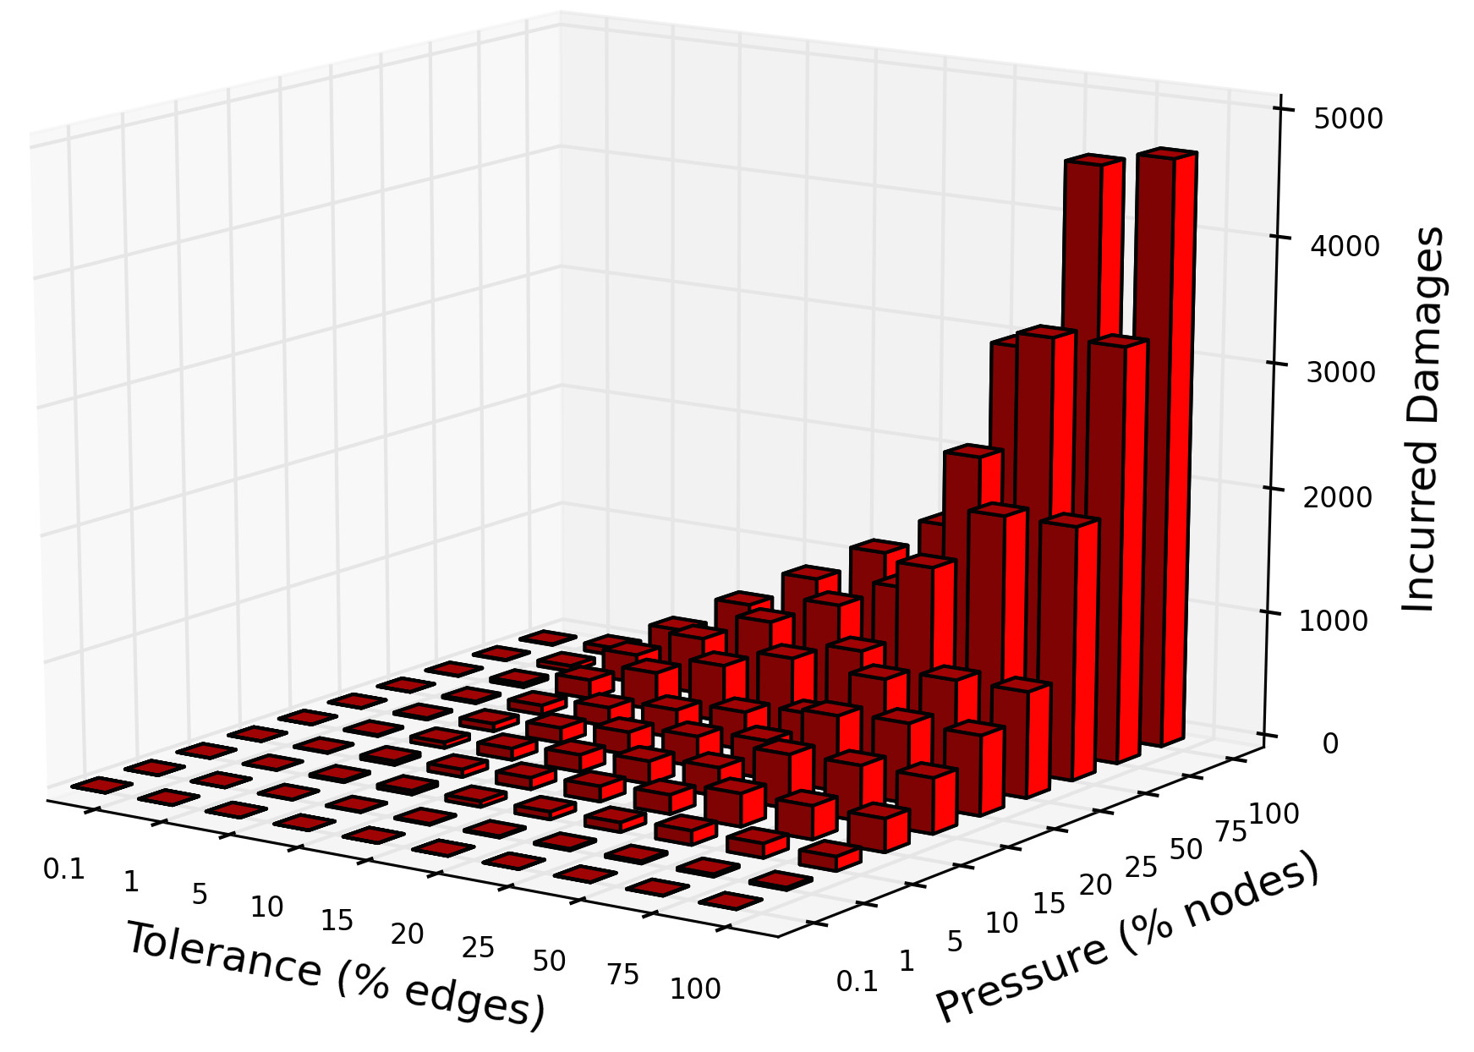
PPI (real bio-network)
ER (PPI’s random analogue)
The total incurred damages (knapsack weight) in the optimal solution

Slide 34
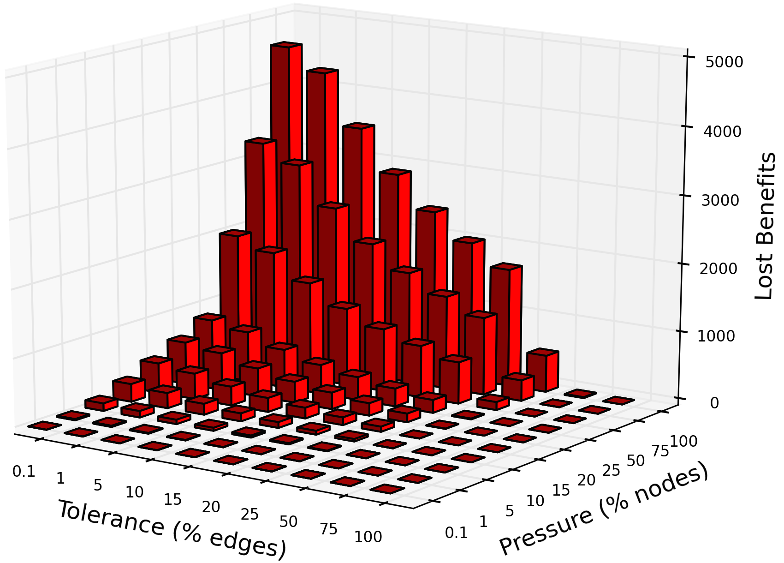
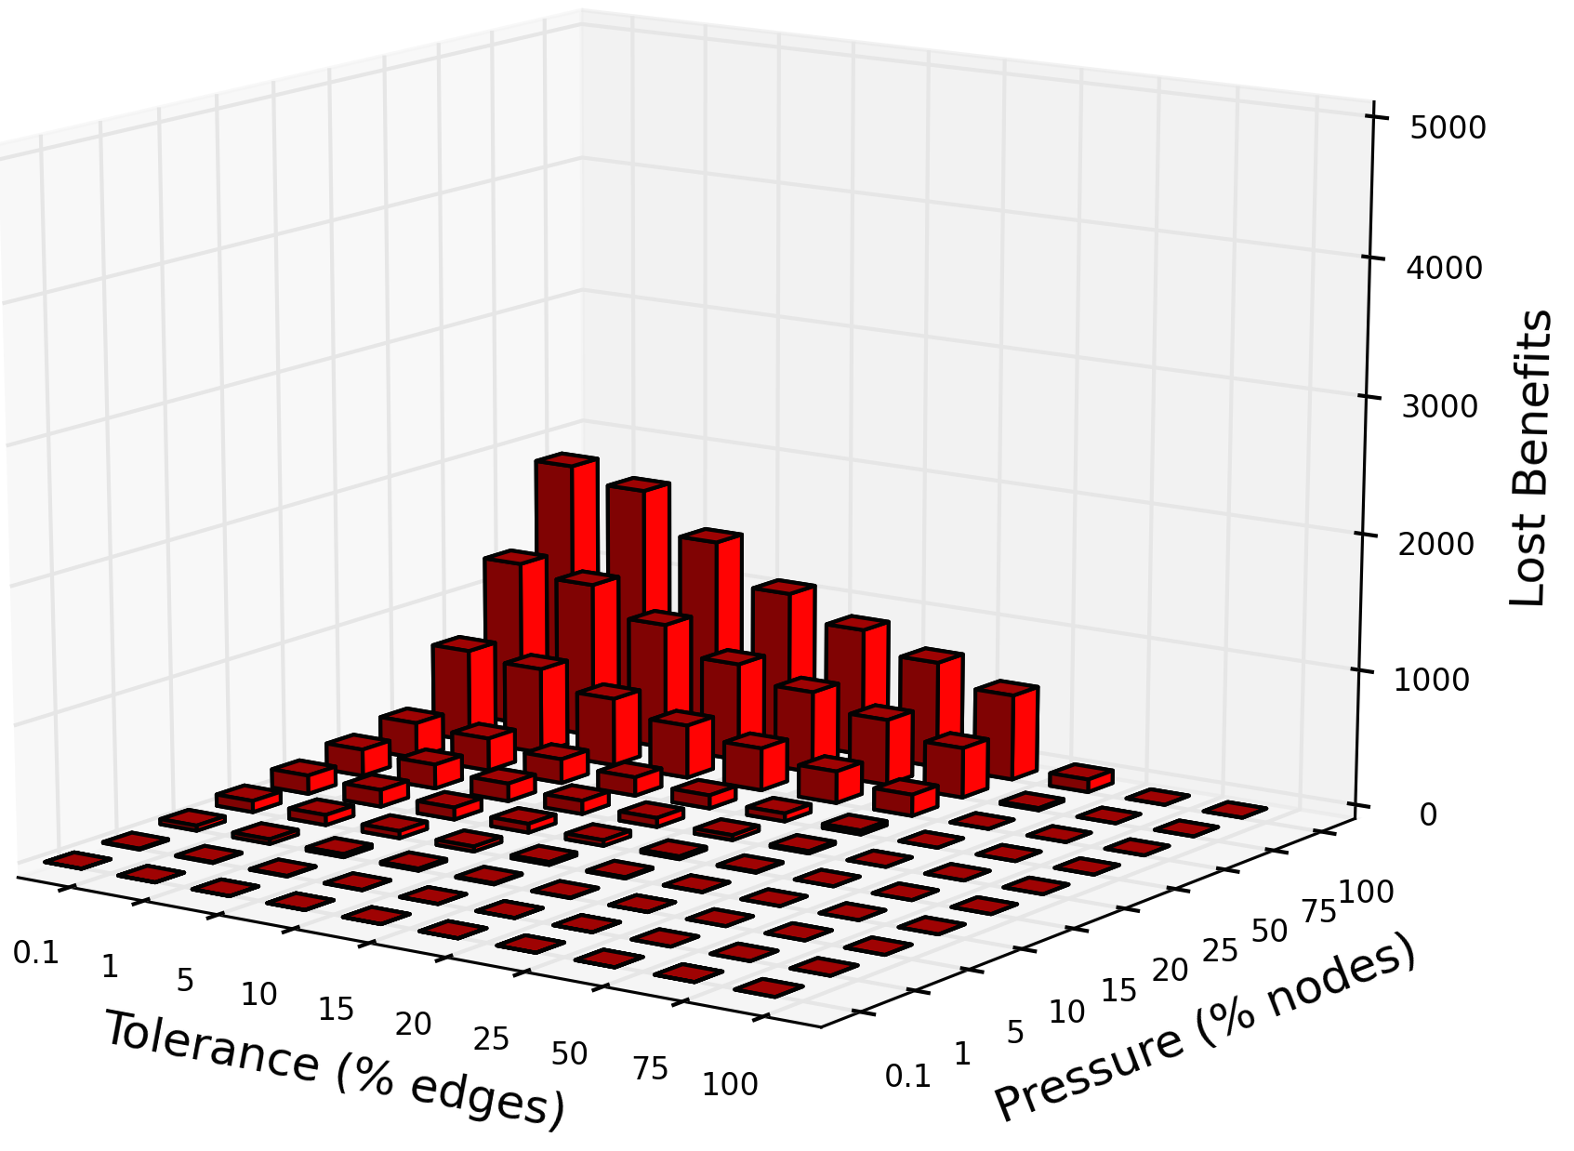
PPI (real bio-network)
ER (PPI’s random analogue)
The total lost benefits (out-of-knapsack value) in the optimal solution

Slide 35
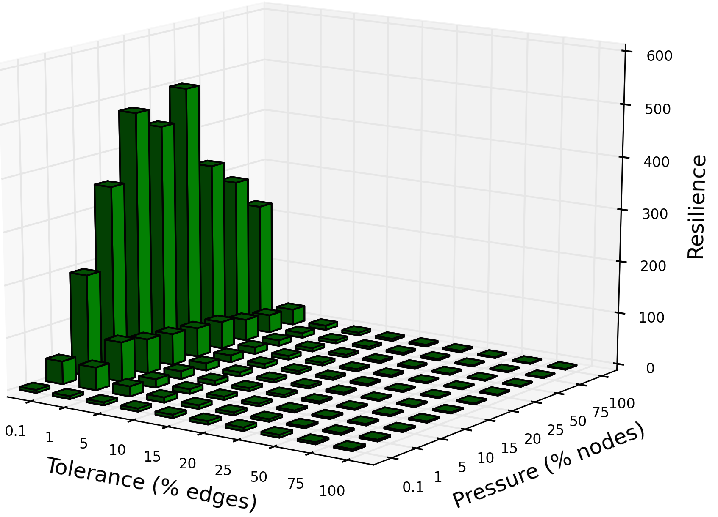
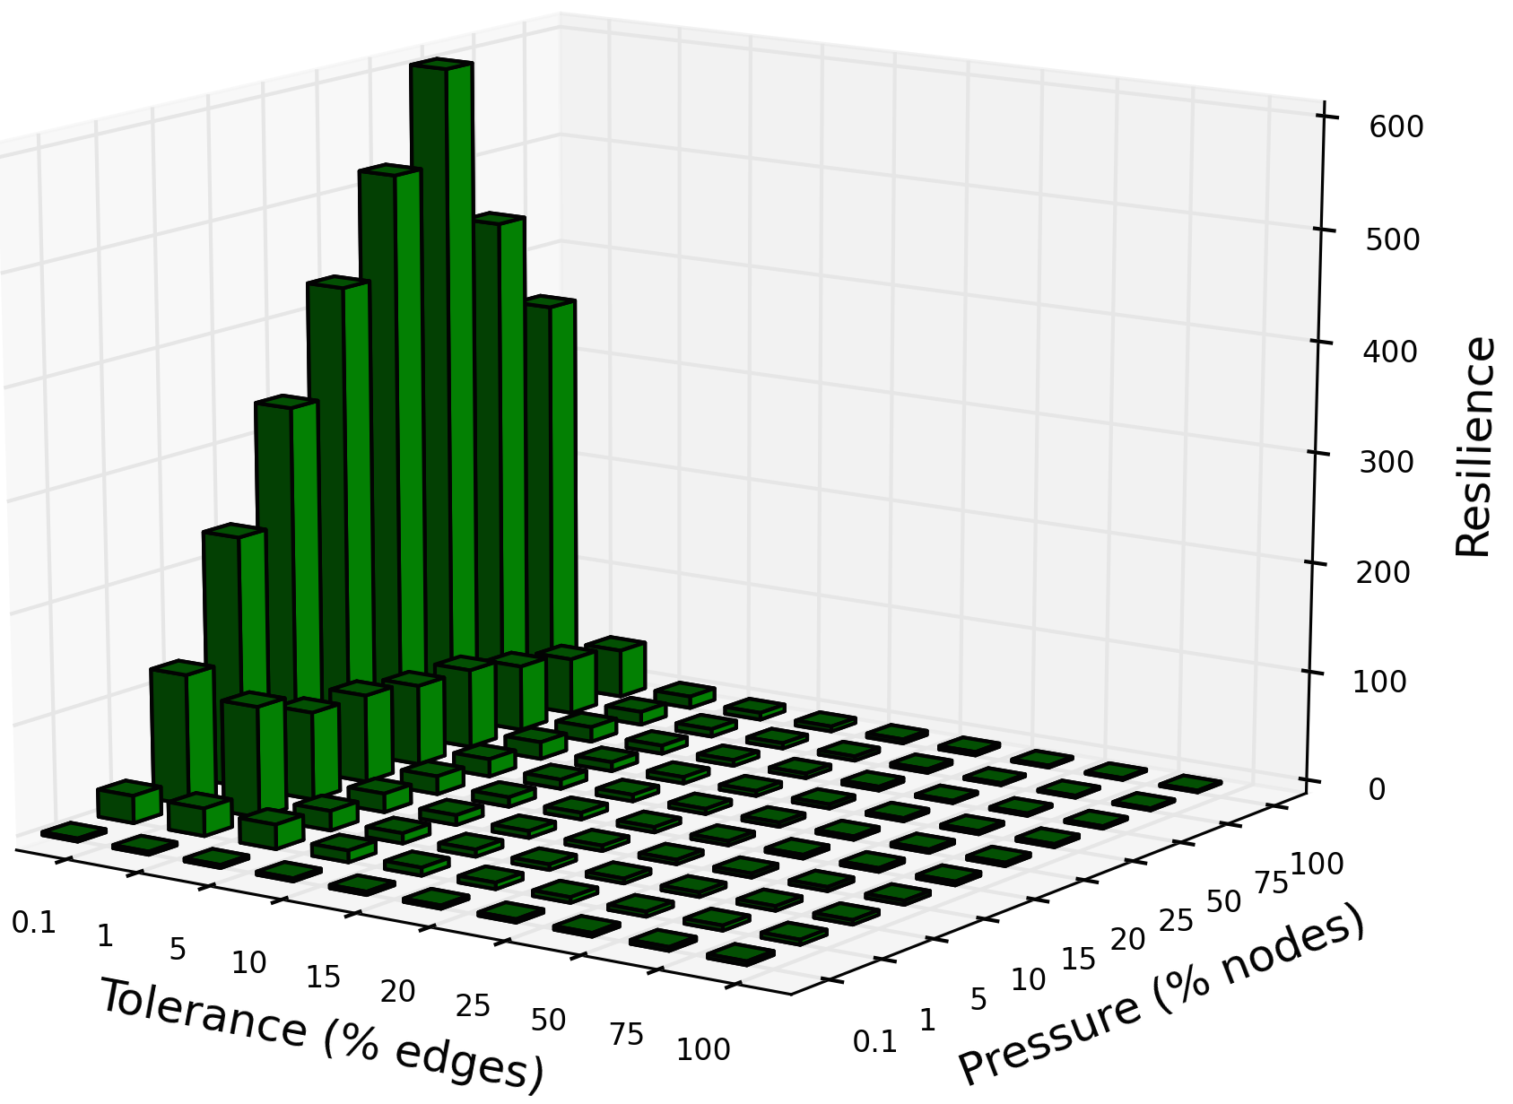
PPI (real bio-network)
ER (PPI’s random analogue)
Resilience: total benefits (inside knapsack) / total damages (inside knapsack)

Slide 36
Working assumptions:
The Church-Turing thesis: nature doesn’t have more computational capabilities than Turing machines (or any of the other Turing-complete computational models).
P != NP, and if it is, nature doesn’t know the polynomial-time algorithm for NP-Complete problems

Slide 37
Experiments with the empirical simulation:
Biased Oracle towards maestro genes (“hub” genes, large in/out degree):
If a gene is repeatedly selected for, its more likely to be beneficial than not (e.g. tumor-repressor p53 protein has been selected for for millions of generations and over time accumulated more and more connections with other genes).
A biased Oracle would preferentially advice to keep such genes (f(g)=1)

Slide 38
The source of resilience in stressed biological networks:
Not only do does a stressed network need to maximize benefits (knapsack value) while minimizing damages (knapsack weight), it must do so with the least effort possible (= with as few addition/deletion of nodes, and as few edge reconfigurations, as possible).
This is (from a computational viewpoint) the justification for the scale-free nature of biological networks.
A few maestro (highly connected) nodes in a scale-free network can fill up the knapsack with the same value as do many lightly-connected nodes in a

Slide 39
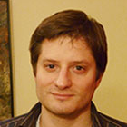
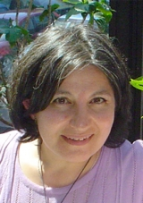



Supervisors:
Dr. Jérôme Waldispühl
Dr. Silvia Vidal
Dr. François Major
Computer Science
McGill University
Human Genetics
McGill University
RNA Engineering
Institute for Research in Immunology and Cancer

Slide 40
Thank you

